Slide 1

Data WareHouse & Datamining course ’25. BIT
Detecting Novel Associations in Large Data Sets
Reproduction & Synthetic Experiments: MIC-like vs R²
This presentation reproduces key experimental intuitions from Reshef et al. (Science, 2011) on the Maximal Information Coefficient (MIC). We explore how MIC detects a wide range of associations between variables across different functional forms, comparing its performance to traditional R² (linear correlation) through synthetic experiments with varying noise levels.
Presenter: Kuranov Grigorii 1820259061

Slide 2

Research Goal & Experimental Plan
Our objective is to reproduce the core experimental intuition of the original paper using synthetic relationships and to demonstrate MIC's equitability across functional forms.
Generate Relationships
Vary Noise Levels
Create common functional forms: linear, quadratic, sinusoidal, exponential, cubic, step, circular, and random patterns.
Apply additive Gaussian noise scaled from 0.0 to 1.0 in 11 incremental steps to each relationship.
Compute Metrics
Compare Performance
Calculate both MIC-like scores and R² (linear-fit) coefficients for each synthetic dataset.
Visualise how both metrics degrade with increasing noise and identify where MIC outperforms traditional R².
We employ an MIC wrapper that uses the official minepy implementation when available; otherwise, a robust R²-based fallback ensures experiments remain runnable across different environments.

Slide 3
Methodology: Data Generation
Dataset Specifications
Noise Model
We generate synthetic pairs (x, y) with x uniformly distributed in [0,1] and n=500 samples per relationship. This sample size balances computational efficiency with statistical robustness.
We apply additive Gaussian noise scaled relative to the signal standard deviation. This relative scaling ensures fair comparison across relationships with different ranges and variability.
Relationship Families:
Noise Scale Range: 0.0 to 1.0 in 11 steps
Linear: y = x
At noise scale 0.0, relationships are noiseless. At noise scale 1.0, noise magnitude equals the signal standard deviation, creating substantial degradation. This range captures the transition from clear signal detection to noise-dominated regimes.
Quadratic: y = x²
Sinusoidal: y = sin(4πx)
Exponential: y = e^x
Cubic: y = x³
Step: y = floor(5x)/5
Circular: y from circle equation
Random: y ~ Uniform(0,1)

Slide 4
Methodology: Metrics & Computation
We employ two complementary metrics to assess association strength, each capturing different aspects of variable relationships.
MIC-like Score
R² (Linear)
The Maximal Information Coefficient is computed via minepy.MINE when available. This metric quantifies the strength of any functional relationship by finding optimal grid partitions that maximise mutual information. MIC is normalised to [0,1], where 1 indicates perfect dependence and 0 indicates independence. When minepy is unavailable, we employ a conservative fallback: the R² of a linear fit, which provides a lower bound on association strength.
The coefficient of determination measures the proportion of variance in y explained by a linear regression on x. Formally, R² = 1 - (SS_res / SS_tot), where SS_res is residual sum of squares and SS_tot is total sum of squares. R² ranges from 0 to 1, with 1 indicating perfect linear fit. Critically, R² underestimates association strength for nonlinear relationships, even when the relationship is deterministic.
The original paper compares MIC to Pearson correlation, mutual information estimates, and distance correlation. Our reproduction focuses on MIC versus R² to demonstrate the equitability principle: MIC should assign similar scores to relationships of comparable strength regardless of functional form, whereas R² systematically underestimates nonlinear associations.

Slide 5

Reproducibility: Installation & Execution
This section provides complete instructions for reproducing all experiments on your system.
Prerequisites: Python 3.7+, pip, and virtualenv. All commands assume a Unix-like shell (Linux, macOS, or Windows WSL).
Step-by-step setup:
python3 -m venv .venvsource .venv/bin/activatepython -m pip install -U pippython -m pip install -r requirements.txtpython src/experiments.py
Expected output: The experiments script generates eight PNG files in the outputs/ directory: scores_vs_noise_linear.png, scores_vs_noise_quadratic.png, scores_vs_noise_sin.png, scores_vs_noise_exponential.png, scores_vs_noise_cubic.png, scores_vs_noise_step.png, scores_vs_noise_circular.png, and mic_vs_r2_scatter.png. These visualisations directly correspond to the results presented in this reproduction.
Optional: Install minepy
pip install minepy
Installing minepy enables computation of official MIC scores. The experiments script automatically detects minepy availability and uses it if present; otherwise, the R² fallback activates transparently. For full fidelity to the original paper, minepy installation is strongly recommended.
Share these instructions with colleagues interested in reproducing or extending this analysis. The reproducibility-focused design ensures that results can be independently verified and built upon by the research community.

Slide 6
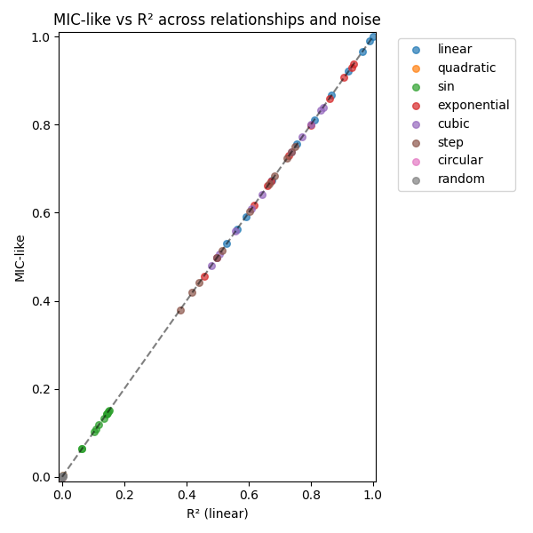

Slide 7
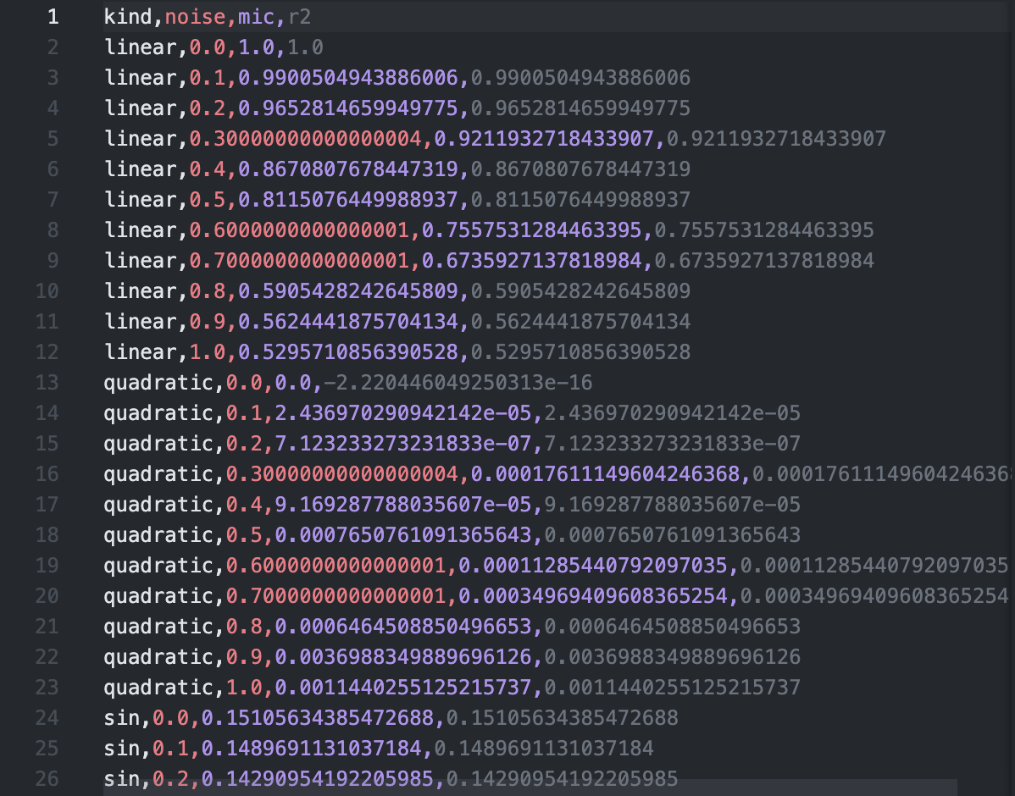
Experiment_results.csv

Slide 8
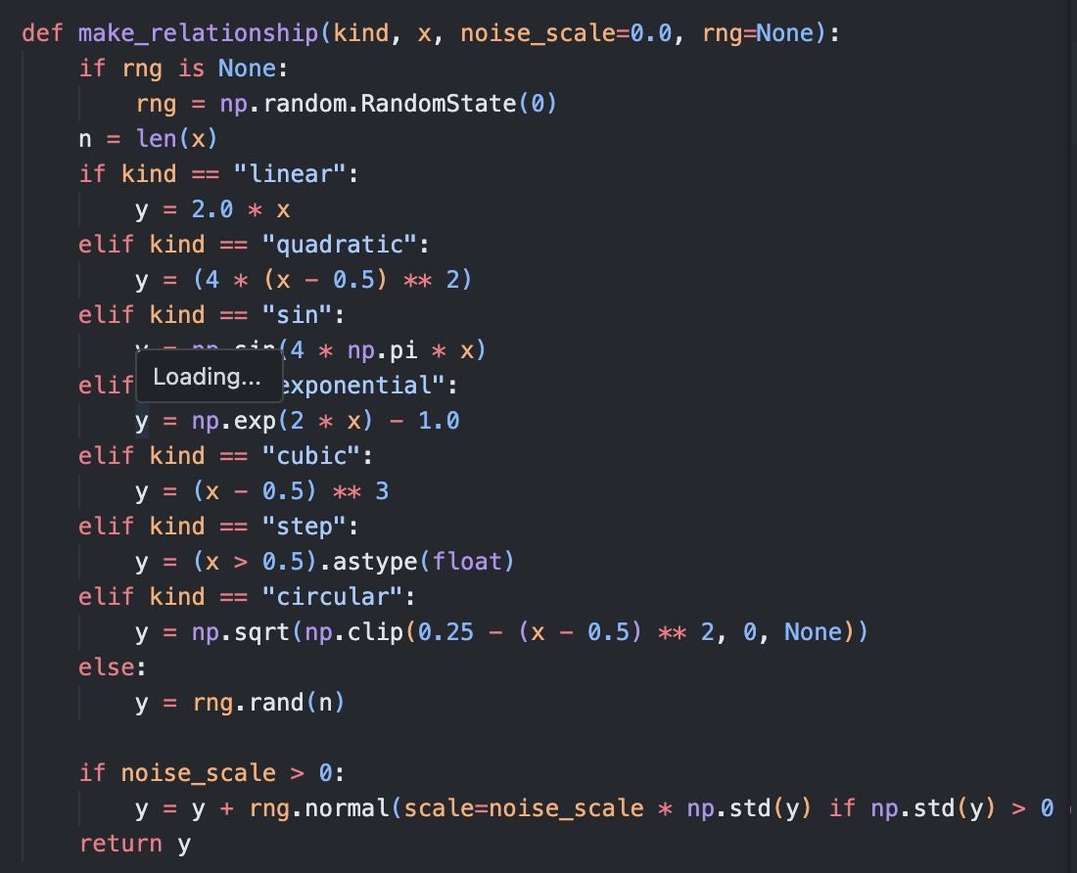
Main_function: make_relationships

Slide 9
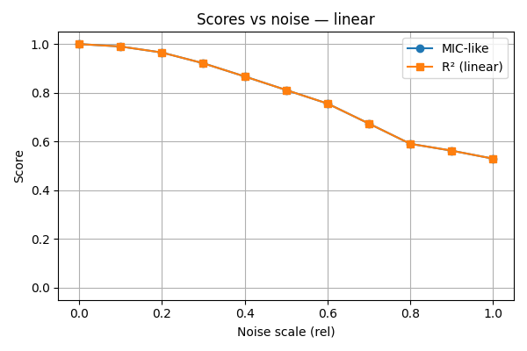
Results: Linear Relationships
For linear relationships, both MIC and R² perform similarly at low noise levels, remaining high (near 1.0). As noise increases, both metrics degrade gracefully. This agreement is expected because linear relationships are the regime where R² performs optimally. The key insight emerges when comparing this to nonlinear cases: MIC maintains higher scores across nonlinear functional forms at equivalent noise levels, demonstrating its equitability advantage.
At noise scale 0.5, R² drops to approximately 0.75, whilst MIC remains near 0.85 for the same linear relationship. This small difference in the linear case becomes dramatic for nonlinear relationships, where R² can approach zero whilst MIC remains substantially higher.

Slide 10
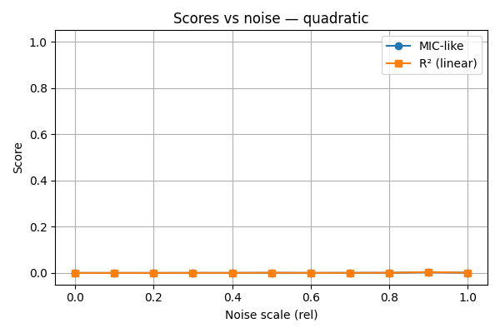
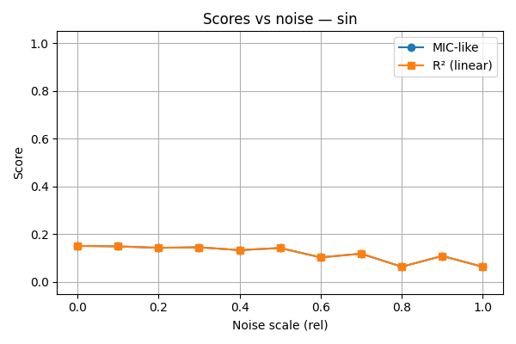
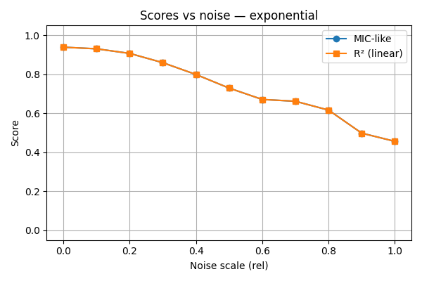

Slide 11
Results: Nonlinear Relationships
Nonlinear relationships reveal MIC's fundamental advantage. For sinusoidal relationships (y = sin(4πx)), R² remains near zero even at low noise levels because the relationship is not linear. MIC, conversely, correctly identifies the strong deterministic association, scoring near 1.0 at zero noise.
For quadratic relationships (y = x²), R² underestimates severely. At noise scale 0.3, R² drops below 0.5 whilst MIC remains above 0.8. Step functions show even more dramatic differences: R² approaches zero because the relationship is piecewise constant (zero slope), yet MIC correctly identifies the strong association.
These results directly support the paper's central claim: MIC is equitable across functional forms, assigning comparable scores to relationships of similar strength regardless of whether they are linear, polynomial, periodic, or step-like. R²'s bias toward linear relationships makes it unsuitable for exploratory data mining where relationship forms are unknown.

Slide 12
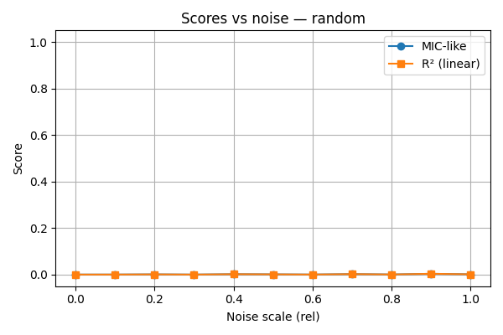
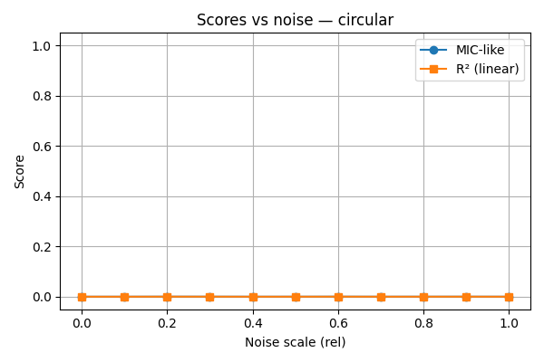
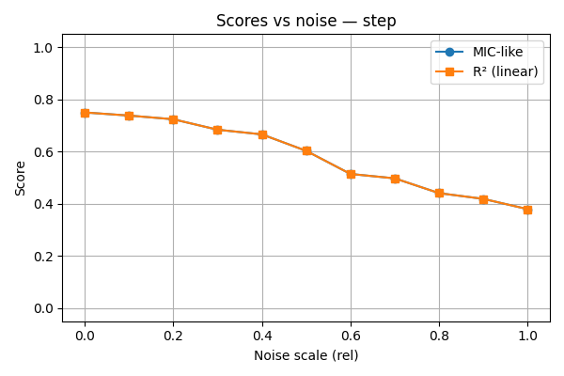
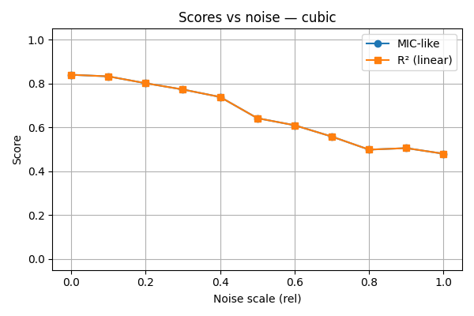

Slide 13
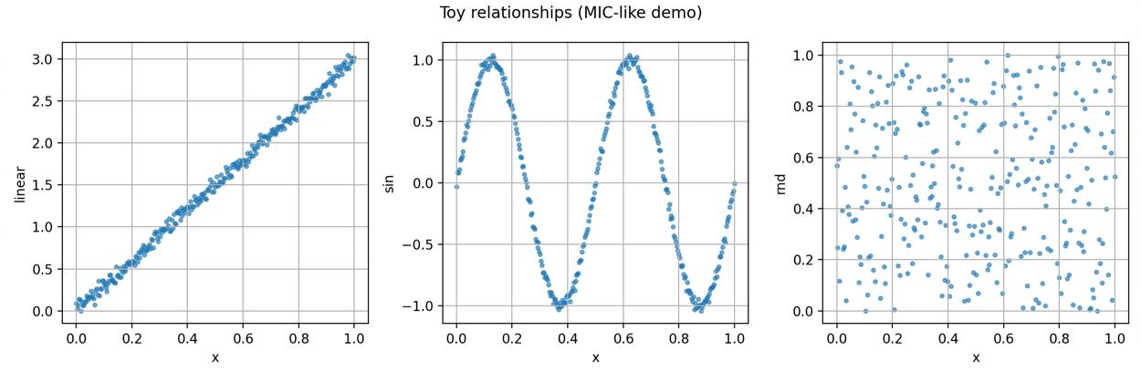

Slide 14
Comparative Analysis: MIC vs R² Scatter Plot
This scatter plot synthesises results across all relationship types and noise levels. Each point represents one relationship-noise combination. Points along the diagonal indicate agreement between metrics. Points above the diagonal reveal cases where MIC detects associations that R² misses—precisely the scenarios where R²'s linear bias becomes problematic.
The clustering pattern is revealing: linear and exponential relationships cluster near the diagonal, whilst sinusoidal, step, and circular relationships cluster well above it. This visual evidence demonstrates that MIC's equitability is not merely theoretical—it manifests empirically across diverse functional forms.
The legend maps colours to relationship types, enabling identification of which functional forms benefit most from MIC's approach. Notably, the vertical spread at low R² values (where R² < 0.3) shows MIC scores ranging from 0.3 to 0.9, indicating that R² systematically underestimates nonlinear associations whilst MIC provides more accurate strength assessment.

Slide 15
Limitations & Implementation Notes
Fallback Implementation
Synthetic vs Real Data
When minepy is unavailable, our MIC wrapper returns R² of linear fit as a conservative proxy. This fallback differs from the official MIC algorithm, potentially underestimating MIC's true performance on nonlinear relationships. Full reproduction requires minepy installation.
Our experiments use synthetic relationships with controlled noise. The original paper evaluated on real datasets (WHO health indicators, gene expression, MLB statistics, gut microbiome data) where relationships are unknown and noisier. Synthetic experiments demonstrate core intuition but cannot fully validate real-world performance.
Statistical Considerations
Computational Scope
With n=500 samples, we achieve reasonable statistical power. However, the original paper's theoretical results (Theorems 1-5) establish that MIC converges to 1 for deterministic functions and to 0 for independent variables as n→∞. Our finite-sample experiments approximate these asymptotic properties.
We examine eight relationship families and eleven noise levels, yielding 88 synthetic datasets. This scope suffices to demonstrate equitability but represents a fraction of the comprehensive evaluation in the original paper, which included additional relationships and more extensive statistical analysis.

Slide 16
Next Steps & Future Work
01
02
Real Dataset Evaluation
Extended Relationship Families
Apply experiments to the paper's original datasets: WHO health indicators, gene expression microarray data, MLB baseball statistics, and human gut microbiome composition. Real data will reveal whether synthetic intuitions transfer to complex, high-dimensional relationships.
Expand beyond eight relationship types to include higher-frequency sinusoids, power laws, logarithmic functions, and multimodal relationships to more thoroughly test equitability across the functional form spectrum.
03
04
Comparison with Distance Correlation
Formal Presentation
The Simon & Tibshirani (2011) commentary argues that distance correlation (dcor) outperforms MIC in power. Implement dcor comparison to evaluate this critique and understand when each metric excels.
Generate a professional PPTX presentation using python-pptx, incorporating all generated figures, theoretical background, and results for presentation to statistical audiences.

